Slide 1
Bayes for Beginners

Slide 2
Concerns
Future: what is the likelihood that a student will get a CS job given his grades?
Current: what is the likelihood that a person has cancer given his symptoms?
Past: what is the likelihood that Marilyn Monroe committed suicide?
Combining evidence.
Always: Representation & Inference

Slide 3
Basic Idea
Attach degrees of belief to proposition.
Theorem: Probability theory is the best way to do this.
if someone does it differently you can play a game with him and win his money.
Unlike logic, probability theory is non-monotonic.
Additional evidence can lower or raise belief in a proposition.

Slide 4
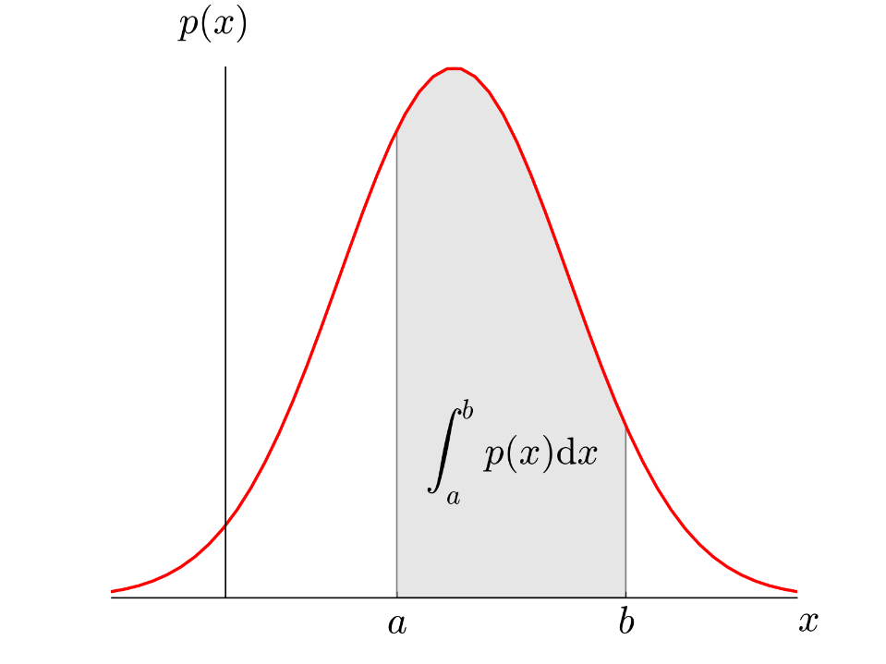


Probability distribution
Discrete
Continuous
X
P(X)
PDF
Height
2
1
1/100
1
…
2
1/100
UK POPULATION
100
…
…
100
1/100
P(X)
PMF
$$\sum_{X}{PMF\left(X\right)=1}$$
X
P(X)
1.8 m
0
1/100
P given by the area
X
$$1.75≤X≤1.85$$
1
2
…
100

Slide 5
Probability
Probability of A occurring: P(A)
Probability of B occurring: P(B)
Joint probability (A AND B both occurring): P(A,B)
Notes:
So, you can have frequentist, or traditional, statistics which will calculate probability based on data without taking into account any previous data or knowledge. Prior knowledge is therefore ignored.
5

Slide 6
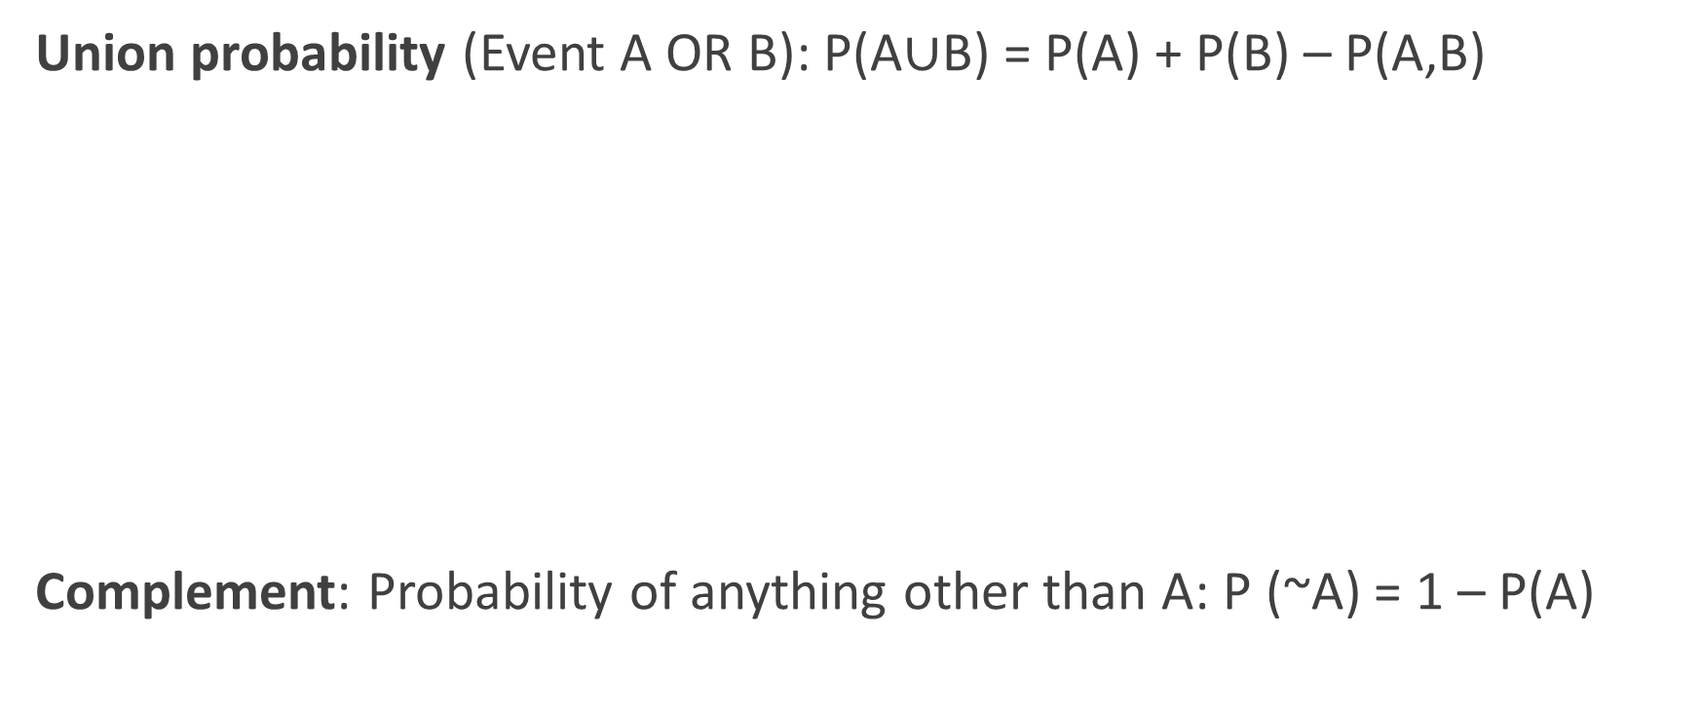

Slide 7



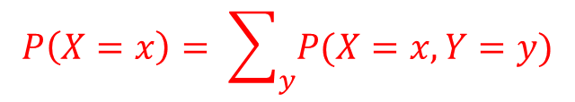

Marginal probability
joint probability :
$$P\left(X=0,Y=1\right)=0.1$$
disease
disease
x
x
$$\sum_{x,y}{P\left(X=x,Y=y\right)=1}$$
0
1
0
0.5
0.1
Y
Y
$$P\left(Y=1\right)=0.1+0.3=0.4$$
symptoms
symptoms
1
0.1
0.3
$$P\left(X=0\right)=0.1+0.5=0.6$$
$$P\left(X=x\right)= \sum_{y}{P(X=x,Y=y)}$$

Slide 8
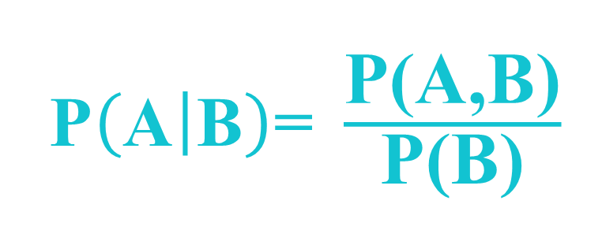
Conditional probability
What is the probability of A occurring, given that B has occurred?
Probability of A given B?
1654: Fermat & Pascal, conditional probability
Notes:
I.E you calculate the joint probability of A and B occurring
8

Slide 9



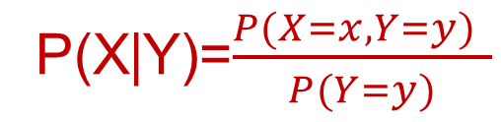






Conditional Probability
joint probability :
joint probability :
$$P\left(X=0,Y=1\right)=0.1$$
$$P\left(X=0,Y=1\right)$$
disease
x
Conditional probability:
0
1
$$P\left(X=1 | Y=1\right)=\frac{0.3}{0.1+0.3}$$
$$P\left(X=1 | Y=1\right)=\frac{0.3}{0.1+0.3}=\frac{3}{4}$$
$$P\left(X=1 | Y=1\right)$$
0.5
$$P\left(X=1 | Y=1\right)=0.3$$
0
0.1
Y
symptoms
$$P\left(X=0 | Y=1\right)=\frac{0.1}{0.1+0.3}$$
1
0.1
0.3
$$P\left(X=0 | Y=1\right)=\frac{0.1}{0.1+0.3}=\frac{1}{4}$$
$$P\left(X=0 | Y=1\right)=0.1$$
$$P\left(X=0 | Y=1\right)$$
P(X|Y)=$\frac{P(X=x,Y=y) }{P(Y=y)}$

Slide 10






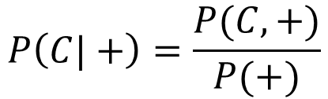
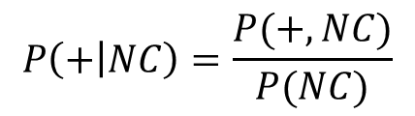



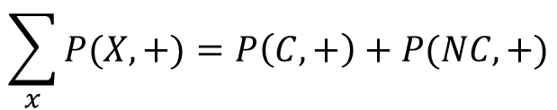


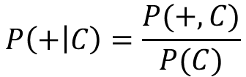

Conditional probability: Example
$$P\left(C\right)=\frac{1}{100}$$
$$P\left(NC\right)=\frac{99}{100}$$
$$P\left(+|C\right)=\frac{90}{100}$$
$$P\left(+|NC\right)=\frac{8}{100}$$
$$P\left(C|+\right)= ???$$
$$P\left(+ | C\right)=\frac{P(+,C)}{P(C)}$$
$$P\left(C,+\right)=P\left(+ | C\right)×P\left(C\right)=\frac{90}{100}×\frac{1}{100}$$
$$P\left(C|+\right)=\frac{P(C,+)}{P(+)}$$
$$P\left(+ | C\right)=$$
$$P\left(C,+\right)=P\left(+ | C\right)×P\left(C\right)=\frac{9}{1000}$$
$$P\left(C,+\right)=P(+|C)×P(C)$$
$$\sum_{x}{P(X,+})=P\left(C,+\right)+P(NC,+)$$
$$\sum_{x}{P(X,+})$$
$$P\left(+\right)=$$
$$P\left(+ | NC\right)=\frac{P(+,NC)}{P(NC)}$$
$$P\left(+,NC\right)=P\left(+ | NC\right)×P\left(NC\right)=\frac{8}{100}×\frac{99}{100}=\frac{792}{10000}$$
$$P\left(+,NC\right)=P(+|NC)×P(NC)$$

Slide 11
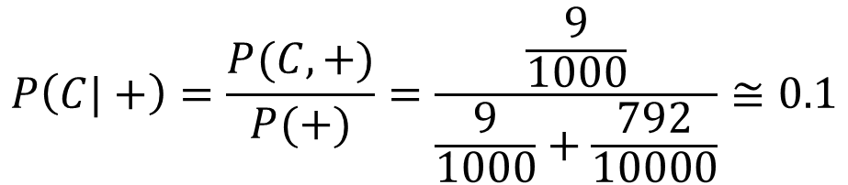
Conditional probability: Example
$$P\left(C\right)=\frac{1}{100}$$
$$P\left(NC\right)=\frac{99}{100}$$
$$P\left(+|C\right)=\frac{90}{100}$$
$$P\left(+|NC\right)=\frac{8}{100}$$
$$P\left(C|+\right)= ???$$
$$P\left(C|+\right)=\frac{P(C,+)}{P(+)}=\frac{\frac{9}{1000}}{\frac{9}{1000}+\frac{792}{10000}}≅0.1$$

Slide 12
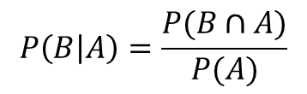
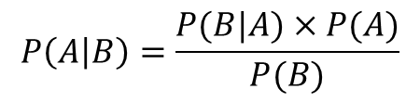

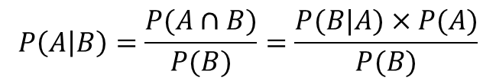
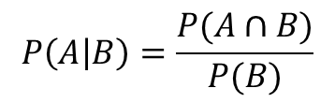

Derivation of Bayes’ theorem
Bayes’ theorem
$$P\left(A | B\right)=\frac{P(B|A)×P(A)}{P(B)}$$
$$P\left(A | B\right)=\frac{P(A∩B)}{P(B)}=\frac{P(B|A)×P(A)}{P(B)}$$
$$P\left(A | B\right)=\frac{P(A∩B)}{P(B)}$$
1
$$P\left(B | A\right)=\frac{P(B∩A)}{P(A)}$$
2
$$P\left(B | A\right)=\frac{P(B∩A)}{P(A)}=\frac{P(A∩B)}{P(A)}$$
$$P\left(A∩B\right)=P\left(B | A\right)×P(A)$$
Reverend Bayes: 1750’s

Slide 13

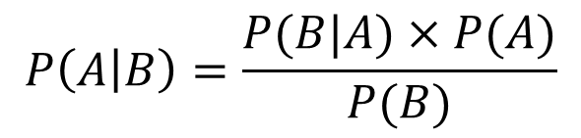
Bayes’ theorem, alternative form
$$P\left(A | B\right)=\frac{P(B|A)×P(A)}{P(B)}$$

Slide 14
Bayes’ theorem problems

Slide 15
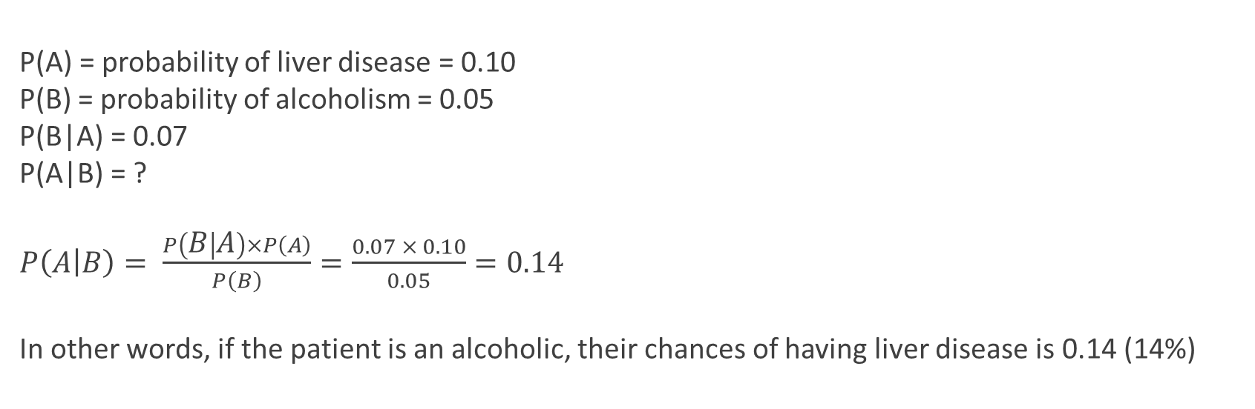
Example 1
10% of patients in a clinic have liver disease. Five percent of the clinic’s patients are alcoholics. Amongst those patients diagnosed with liver disease, 7% are alcoholics. You are interested in knowing the probability of a patient having liver disease, given that he is an alcoholic.

Slide 16
Example 2
A disease occurs in 0.5% of the population
A diagnostic test gives a positive result in:
99% of people with the disease
5% of people without the disease (false positive)
A person receives a positive result
What is the probability of them having the disease, given a positive result?
Notes:
16

Slide 17
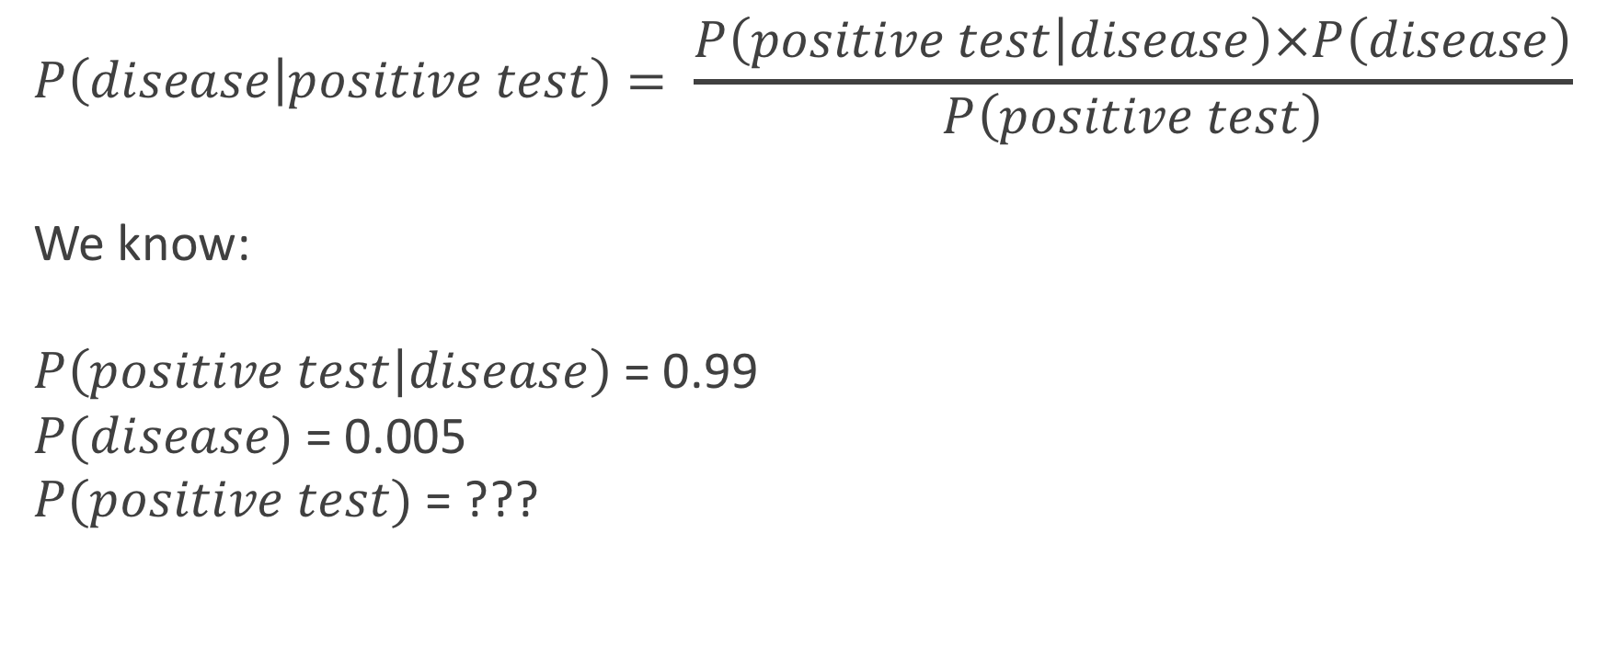
$$P\left(disease | positive test\right)= \frac{P\left(positive test | disease\right)×P\left(disease\right)}{P\left(positive test\right)}$$
We know:
$P\left(positive test | disease\right)$= 0.99
$P(disease)$= 0.005
$P(positive test)$= ???
Notes:
17

Slide 18
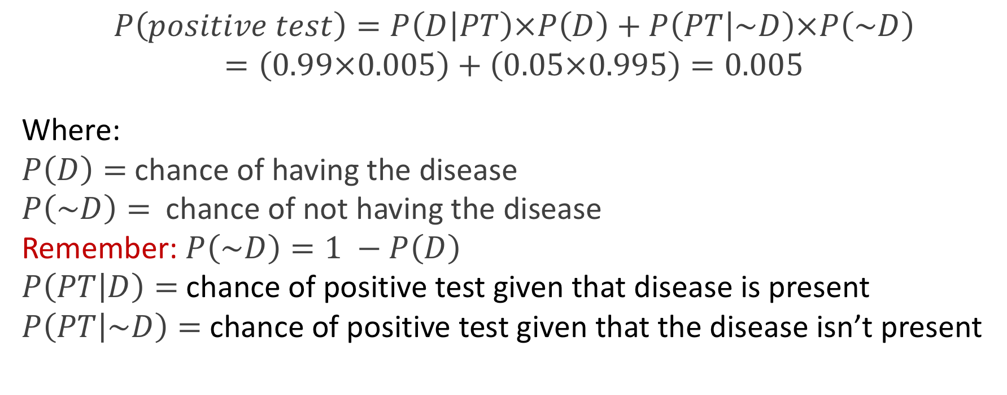
$$P\left(positive test\right)=P\left(D | PT\right)×P\left(D\right)+P\left(PT | \sim D\right)×P\left(\sim D\right)$$
$$=\left(0.99×0.005\right)+\left(0.05×0.995\right)=0.005$$
Where:
$P\left(D\right)=$ chance of having the disease
$P\left(\sim D\right)=$ chance of not having the disease
Remember: $P\left(\sim D\right)=1 −P\left(D\right)$
$P\left(PT | D\right)=$ chance of positive test given that disease is present
$P\left(PT | \sim D\right)=$ chance of positive test given that the disease isn’t present
Notes:
In this case you calculate the denominator using the following variation on Bayes’s theorem.
18

Slide 19
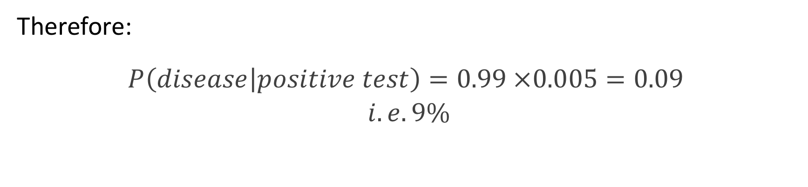
Therefore:
$$P\left(disease | positive test\right)=0.99 ×0.005=0.09$$
$$i.e. 9\%$$
Notes:
19

